Slide 1

Plant Disease Detection And Classification Using Deep Learning
(BACHELOR OF TECHNOLOGY)
(Computer Science & Engineering)
Submitted by
ML_CS-21 NAYAN KUMAR
Under the Supervision of
Dr Rinku Datta Rakshit

Slide 2
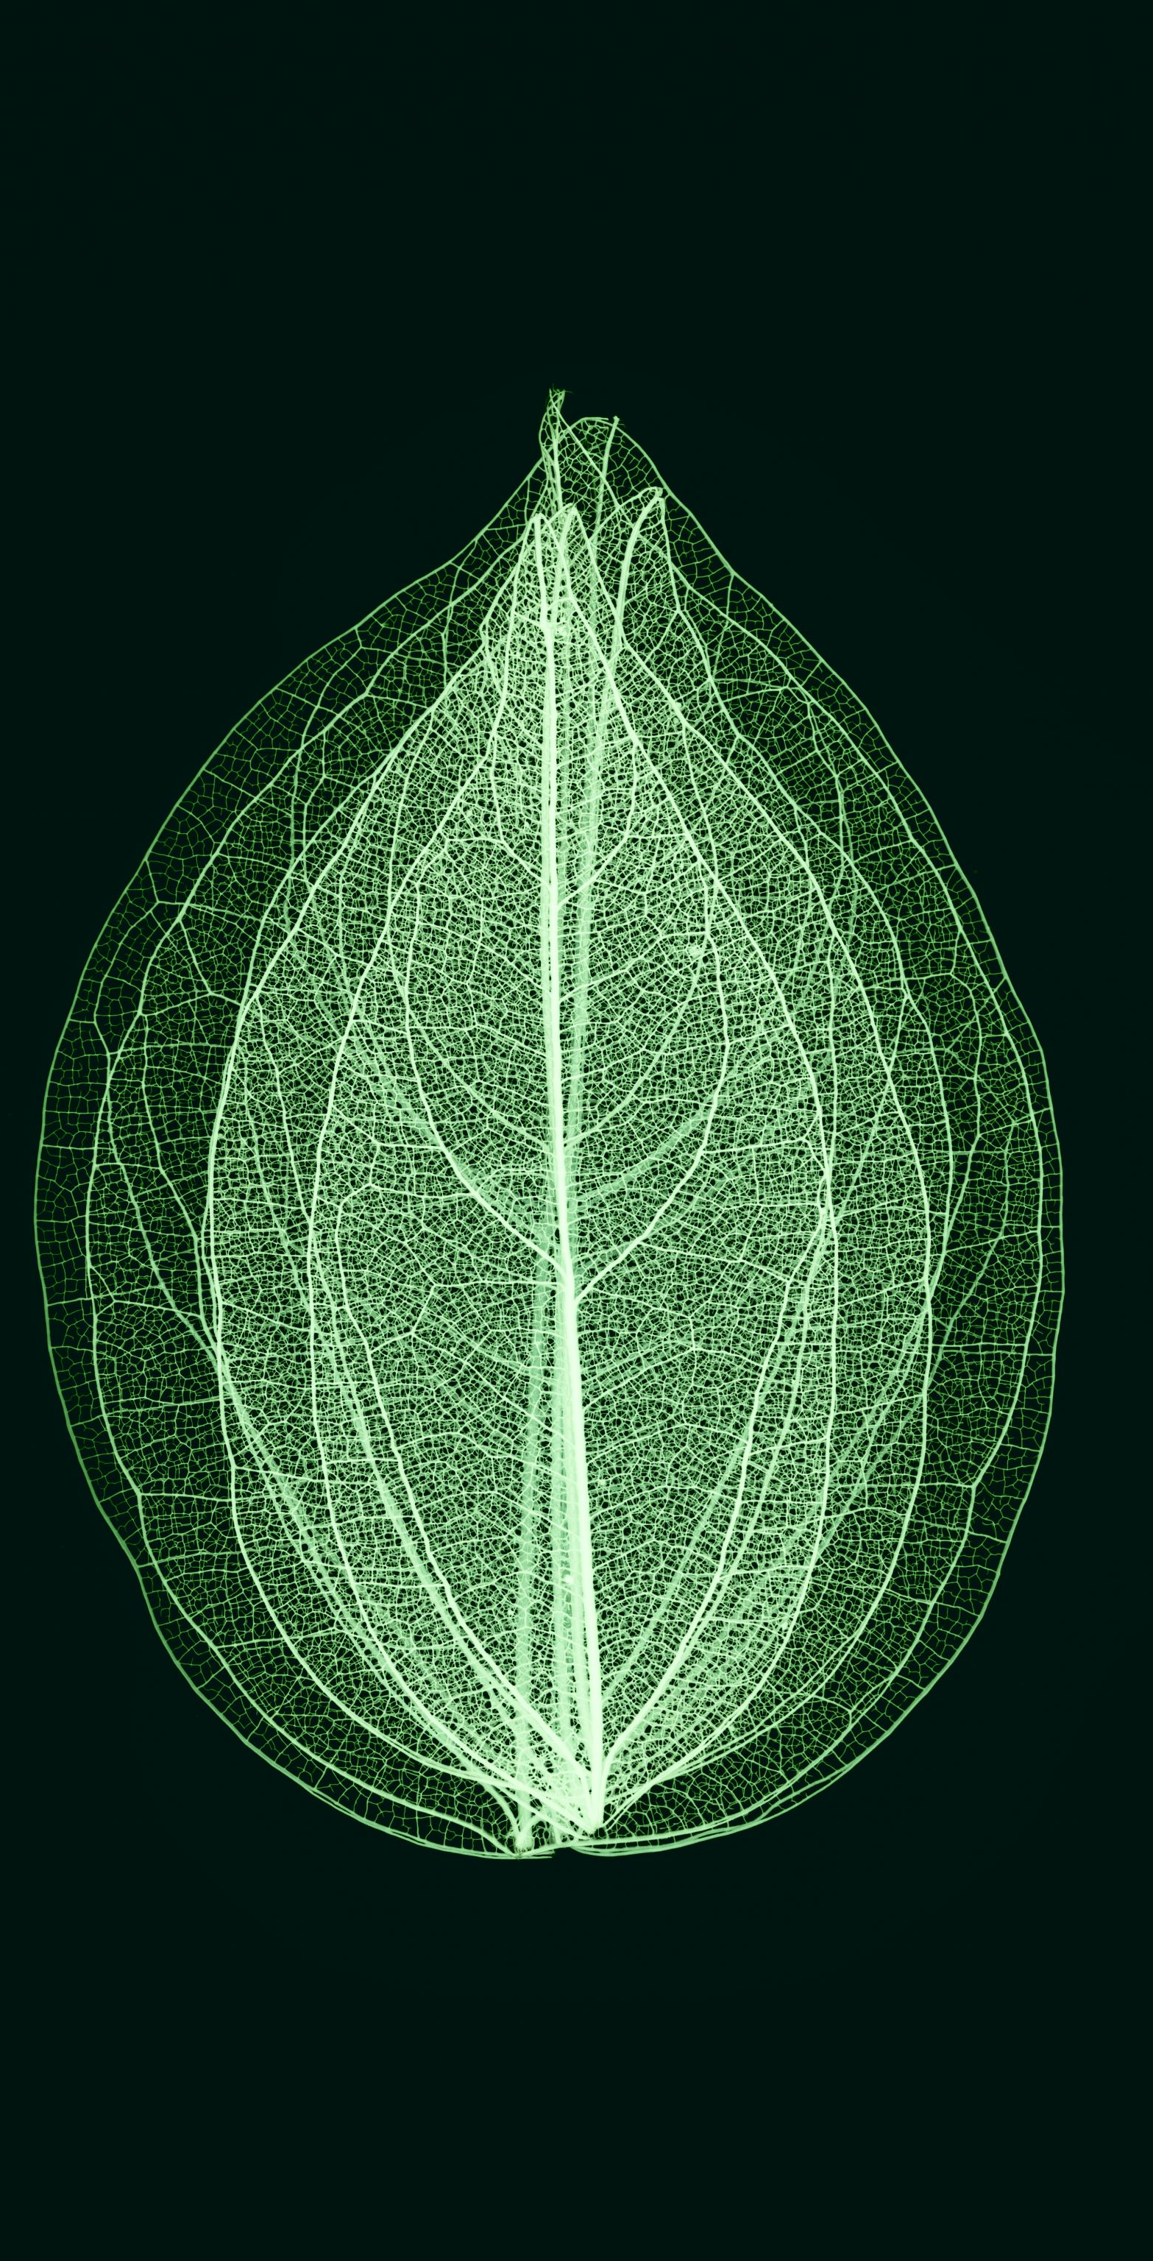
ABSTrACT
Explore modern techniques revolutionizing plant leaf disease detection. Traditional methods like visual inspection are limited, paving the way for machine learning algorithms, including Convolutional Neural Networks (CNNs), image processing, and sensor-based technologies. CNNs enable automated disease classification from leaf images with unprecedented accuracy. Sensors like hyperspectral imaging provide non-invasive insights into plant physiology. Challenges include algorithm robustness and device portability. Collaboration and data sharing are vital for comprehensive disease detection systems, promising enhanced crop management, sustainable agriculture, and global food security. Integration of multiple data sources and scalability are critical for future advancements.

Slide 3
contents
Introduction
Dataflow diagram of project (DFD)
Objectives of plant disease detection and classification
Advantages
Simulation requirements
Datasets
AI, Machine Learning and Deep Learning
Necessary libraries
Transfer Learning
Implementation
Future Scope of project
Conclusion

Slide 4
PROBLEM STATEMENT
Diseases found in agricultural crops is a major threat that cause production and economic losses as well as reduction in both quality and quantity of agricultural products.
In India 70% of population depend on agriculture and contributes 17% towards the GDP of country.
Farmers experience great difficulties in switching from one disease control policy to another. The naked eye observation of experts is the traditional approach, this method can be time consuming, expensive and inaccurate.
The crop losses can be minimized by applying pesticides or its equivalent to combat the effect of specific pathogens, if diseases are correctly diagnosed and identified early.

Slide 5
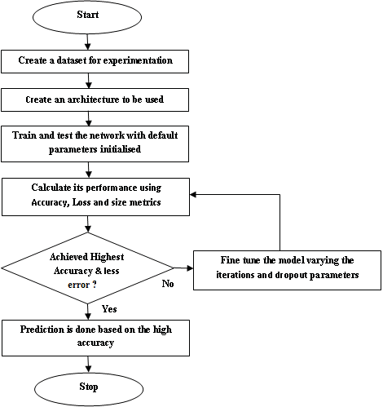
DATAFLOW DIAGRAM OF PROJECT

Slide 6
advantages
The main advantage of automatic plant disease detection is to protect crop production from quantitative losses.
Automatic detection of plant disease is essential as it may prove benefits in monitoring large fields of crops and thus automatically detect the symptoms of diseases as soon as they appear on plant leaves.
This system can work as a universal detector, recognizing general abnormalities on the leaves such as scorching or mold etc.
It can be implemented to increase crop productivity by ensuring the quality and quantity of the food product.

Slide 7
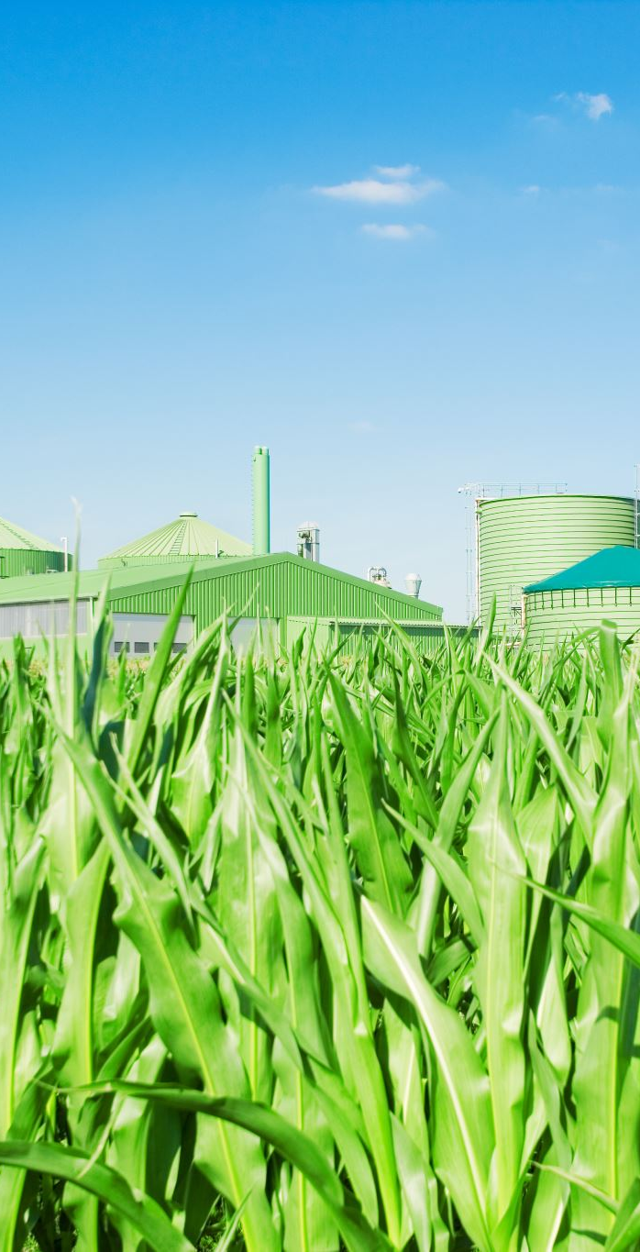
The advantage of automatic plant disease detection and classification is to provide best Agricultural productivity. This is one of the reason that disease detection in plants plays an important role in agriculture field.
It can recognize a plant disease which provides clues to identify and treat the disease in early stages.
It provides the better advancement and enhancement in computing classifiers of a neural network approach and provide better results.
This system will be capable of distinguishing a large no of different diseases in a less time.

Slide 8
objectives of Automatic Plant Disease Detection
Forecasting of plant leaf disease (Quantification) as soon it appears on plant leaves.
Automatic detection of plant leaf disease detection and classification.
Increase accuracies Using large dataset to train the Algorithm and maximize epoch values.
Make use of existing deep learning models VGG16 and VGG19 for plant leaf disease detection and will check their performance on the basis of various evaluation.

Slide 9
simulation REQUIRMENTS
HARDWARE REQURMENTS
Pc with core i7 processor
8GB RAM or above
300GB hard disk or above
2GB graphic card or above
SOFTWARE REQUIREMENTS
Windows 11
Python 3.12
Anaconda (Jupyter)
Python Packages

Slide 10
Dataset(New Plant Disease Dataset)
The Dataset collected from open source website “Kaggle”.
The Dataset contains 15k image samples of 14 crops.
The dataset consists of 38 classes corresponding to 38 leaf diseases of 14 crops.
the 38 disease are listed bellow and their corresponding images.
1)Apple Scab, 2) Apple black rot, 3)Apple Cedar Rust, 4)Apple healthy,5)Blueberry Healthy, Cherry Healthy,6)Cherry powdery Mildew,7)Corn Gray Leaf Spot,8)Corn Common Rust,9)Corn Healthy,10) Corn Northern Leaf,11)Grape Black Rot,12)Grape Black Measles,13)Grape Healthy, 14)Grape Black Rot,15)Grape Black Measles,16)Grape Healthy,17)Frape Leaf Blight,18)Orange Haunglongbing, 19)Peach Bacterial Spot,20)Peach Healthy,21)Bell Paper Bacterial Spot,22)Bell Paper Healthy,23)Potato Early Blight,24)Potato Healthy,25)Potato Late Blight,26)Raspberry Healthy, 27)Soybean Healthy,28)Squash Powdery Mildew,29)Strawberry Healthy,30)Strawberry Leaf Scorch, 31)Tomato Bacterial Spot,32)Tomato Early Blight,33)Tomato Late Blight,34)Tomato Leaf Mold,35)Tomato Two Spotted Spider,36)Tomato Mosaic Virus,37)Tomato Yellow Leaf Curl Virus,38)Tomato Healthy of plant leaves.

Slide 11
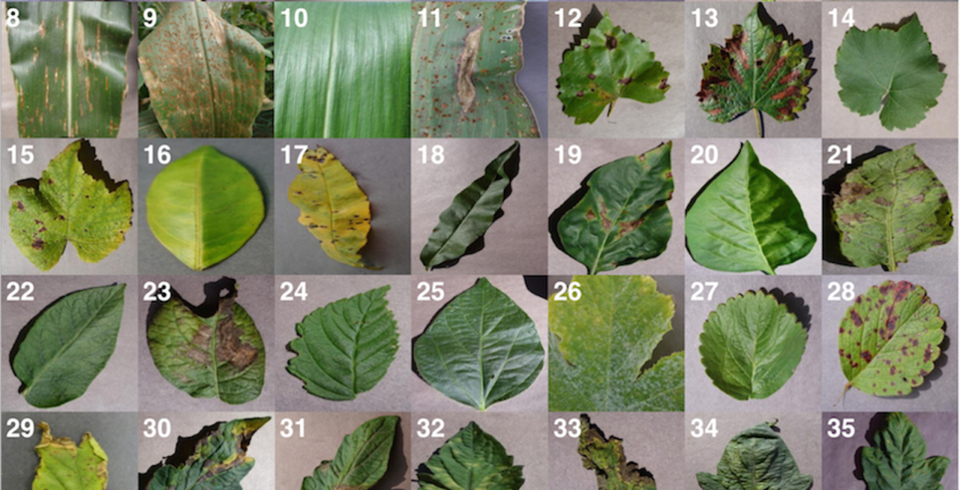

Slide 12
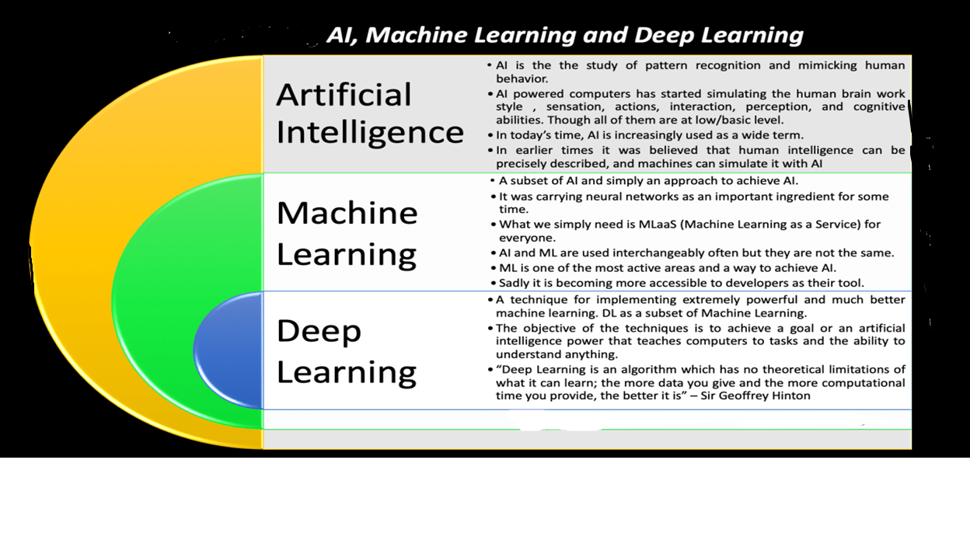
Deep Learning

Slide 13
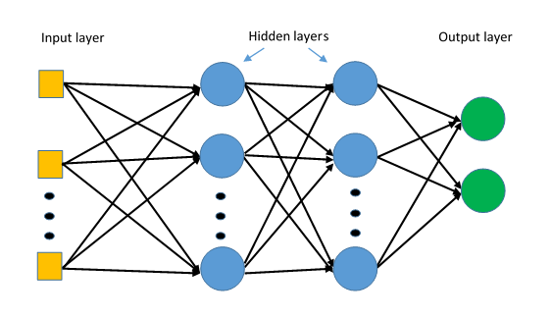
Artificial Intelligence is a technique which allows the machines to act like humans by replicating their behavior and nature.
Machine Learning is a subset of artificial intelligence. It allows the machines to learn and make predictions based on its experience(data).
Deep Learning is a subfield of machine learning concerned with algorithms inspired by the structure and function of the human brain called artificial neural networks.
The ANN architecture is constituted of 3 layers, input layer, hidden layer, and output layer.

Slide 14
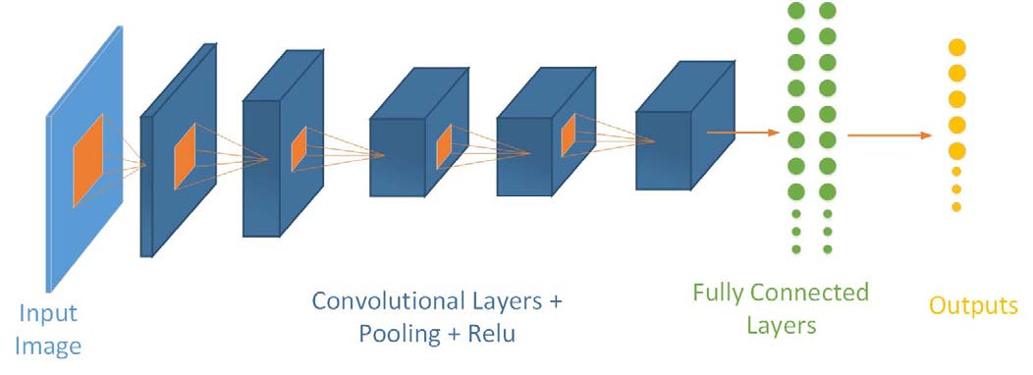
CNN's are feedforward neural networks wherein data moves from the input layer to the output layer.
CNN based classifiers can be directly trained using raw images without the intervention of humans in feature extraction.
CNN's architectures consist of input, hidden, and fully-connected (output) layers.
The hidden layers are convolutional, ReLU (rectified linear unit), and pooling layers which are stacked to form a single network.
CNN can be used to solve classification, clustering, regression, pattern recognition, dimension reduction, structured prediction, machine translation, anomaly detection, decision making, visualization, and computer vision problems.

Slide 15
Necessary Libraries
TensorFlow
Scikit-learn
Keras
Numpy
Matplotlib

Slide 16
TRANSFER LEARNING
Transfer learning is the reuse of a pre-trained model on a new problem.
A pre-trained model is a saved network that was previously trained on a large dataset, typically on a large-scale image-classification task.
Feature Extraction: Use the representations learned by a previous network to extract meaningful features from new samples.
Fine-Tuning: Unfreeze a few of the top layers of a frozen model base and jointly train both the newly-added classifier layers and the last layers of the base model.

Slide 17
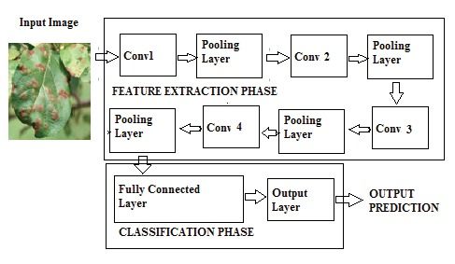
implementation

Slide 18
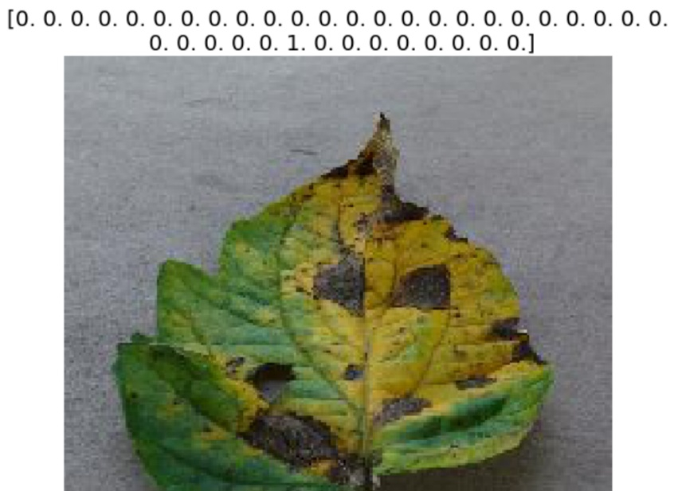
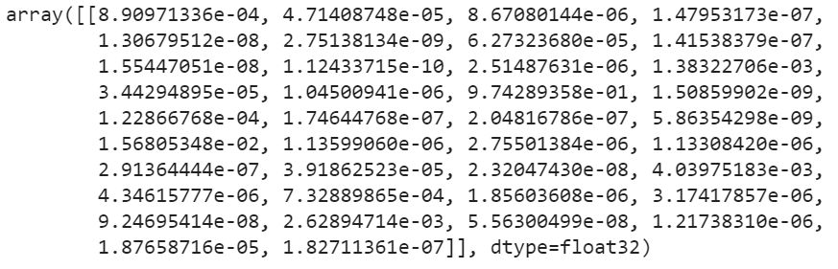
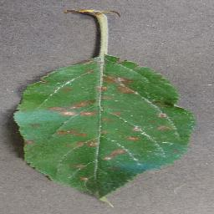
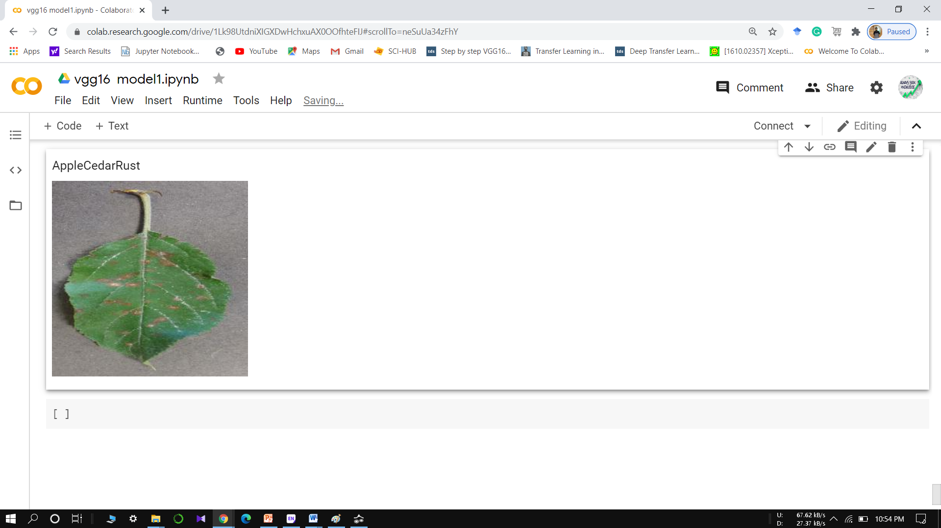
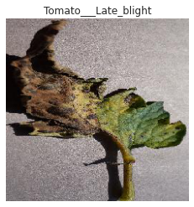
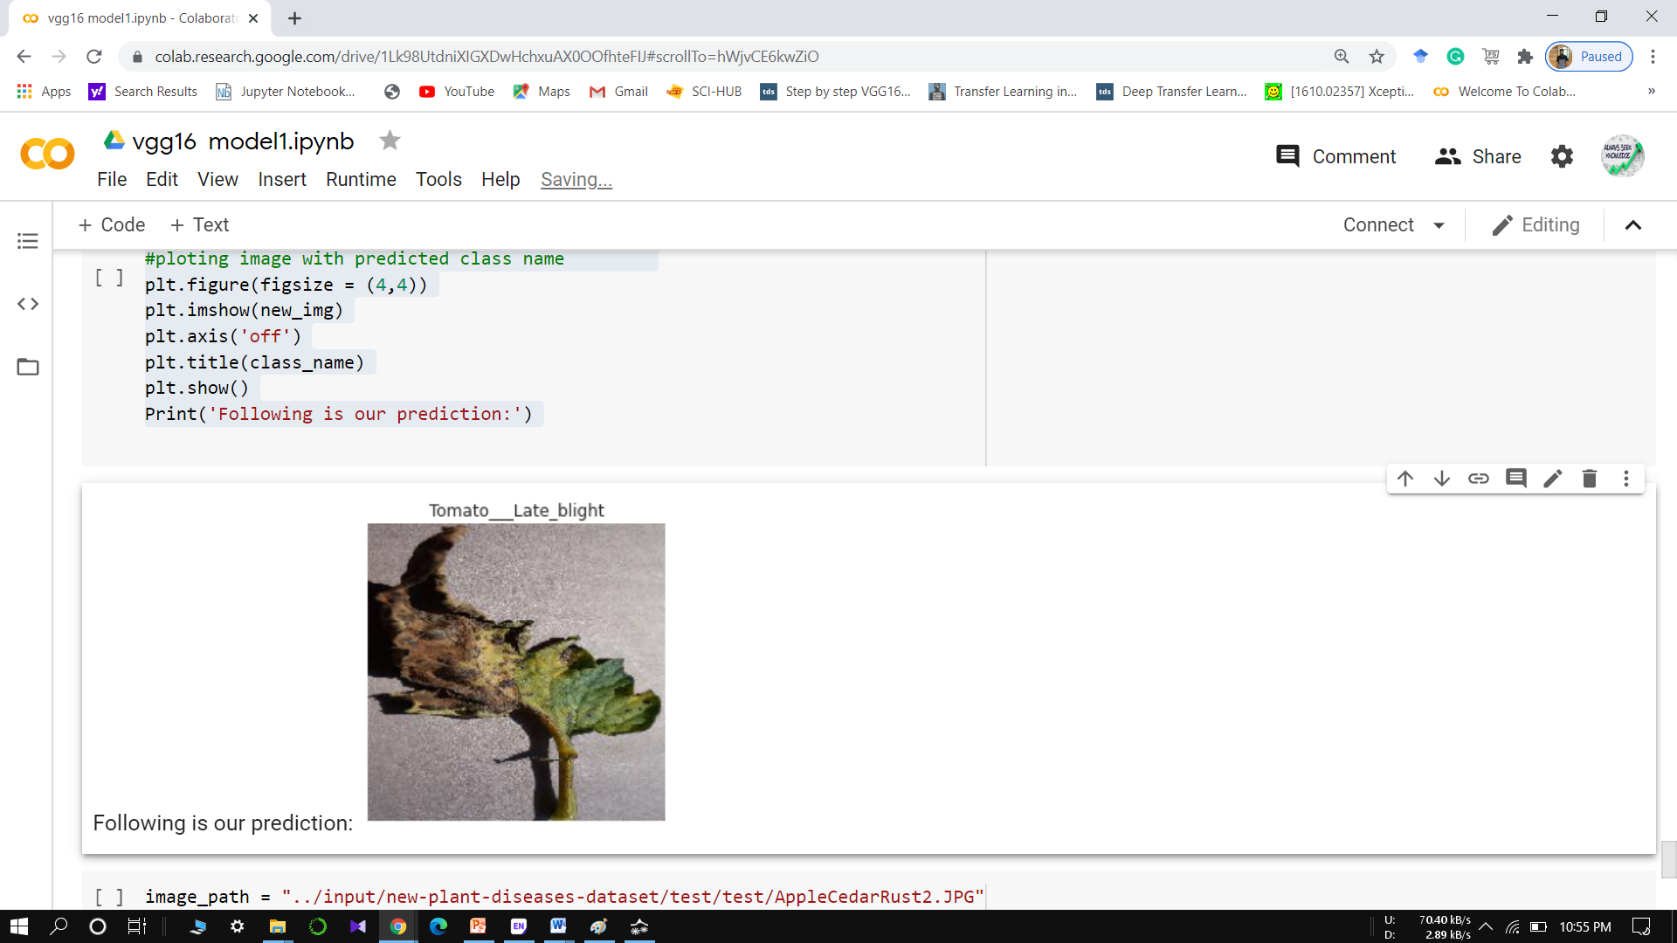
Input image output

Slide 19
Future scope of project
The forecasting of disease diseases in early stage, so that appropriate measures can be taken to minimize the loss in crops.
Our project have shown pretty good accuracy, it can be implemented in real time mobile applications and web services, so that formers can identify diseases simply by taking photo of suspected leaves of plants.
Recommendation of chemicals and their ratio to control the further spread of diseases on the different parts of plants after the proper identification of diseases,
Other than plant leaf disease identification, it can also be used for identification and classification of nutrients deficiency of plant leaves.
Creating and training a CNN model from scratch is a tedious process, this model can be used to detect and classification of other plant disease too, by simply training the model using respected datasets.

Slide 20
Thank you……….

